Slide 1
SI 206 Discussion 4:
Rectangle, the Terminal, and Git

Slide 2
Today
Object oriented programing
Create a rectangle class and methods to calculate the area and perimeter.
Create the rectangle instances, and call the methods
Git : Commit code after each method and push to GitHub in the end

Slide 3
Discussion 4 Assignment
Starter code is on Canvas:
Files ->
Discussions ->
Discussion 4 ->
discussion4_starter.py

Slide 4
Rectangle class
Problem 1. Create the constructor "__init__" method
with arguments width (an integer), height (an integer)
It sets an instance variable, "width" to the passed argument, width
It sets an instance variable, "height" to the passed argument, height
Problem 2. Create the "__str__" method
It returns a string, "A rectangle with width ____ and height ____"

Slide 5
Rectangle class
Problem 3. Create the "verify_input" method
It returns a boolean
True if the width and height are positive numbers
False otherwise
Problem 4. Create the "area" method
It first verifies inputs and return "Invalid input" if they are invalid.
Otherwise, it returns the area of the rectangle.
Problem 5. Create the "perimeter" method
It first verifies inputs and return "Invalid input" if they are invalid.
Otherwise, it returns the perimeter of the rectangle.

Slide 6
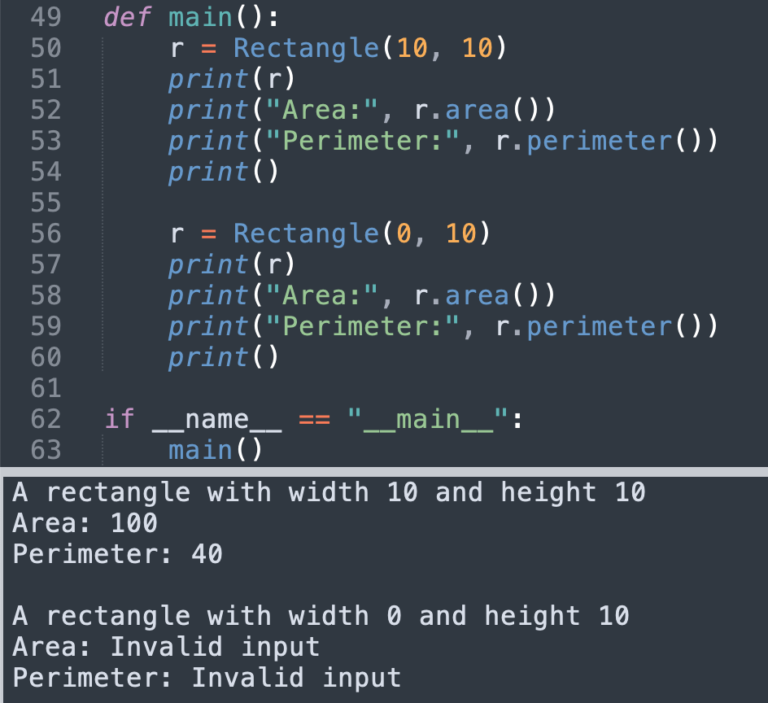
Sample output

Slide 7
Git & Github

Slide 8
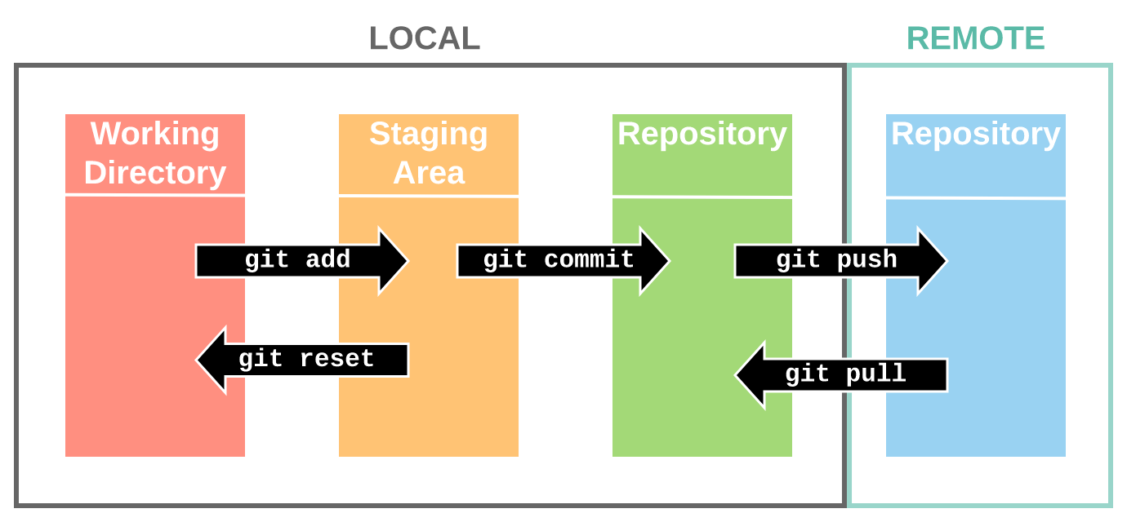

Slide 9
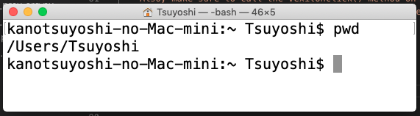
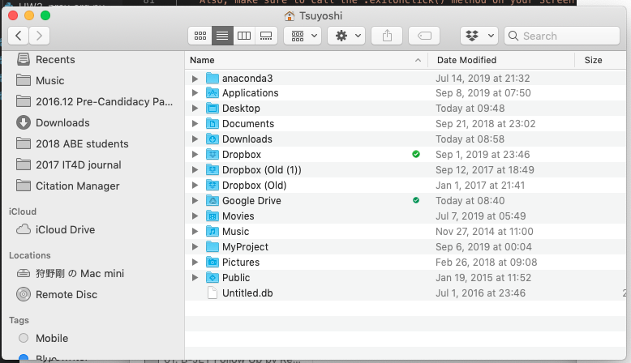
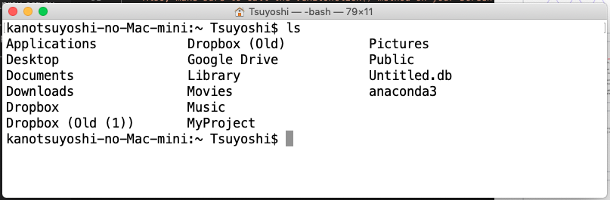
Basic Linux / MS-DOS commands 1
pwd (Mac) / chdir (Win) : Display your location in the file system
ls (Mac) / dir (Win) : Lists files

Slide 10
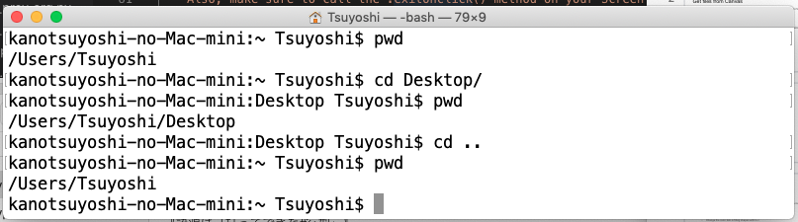
Basic Linux / MS-DOS commands 2
cd pathname: Changes directories
python filename.py / python3 filename.py : Run a python file

Slide 11
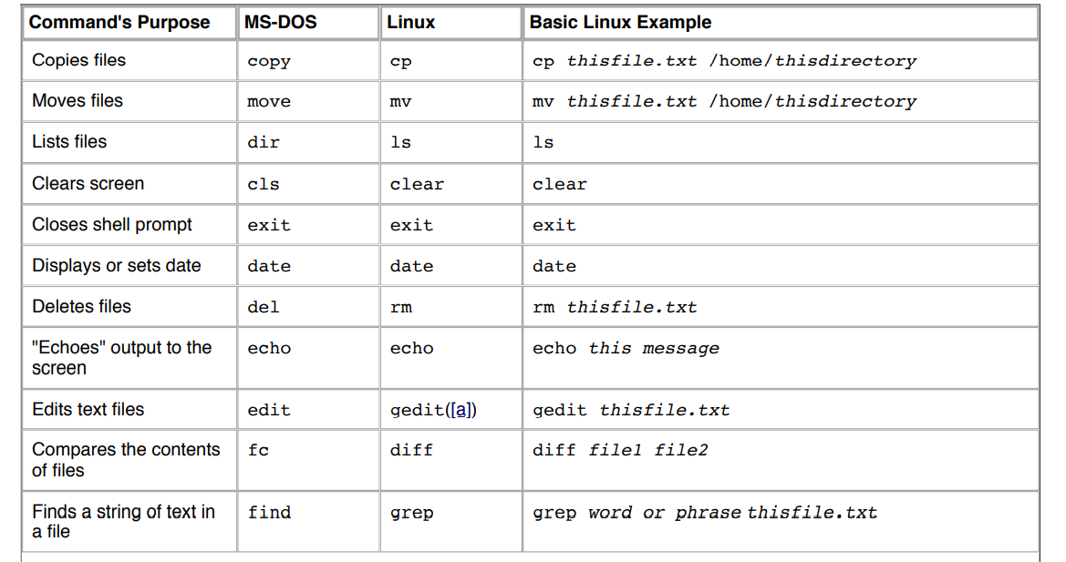

Slide 12
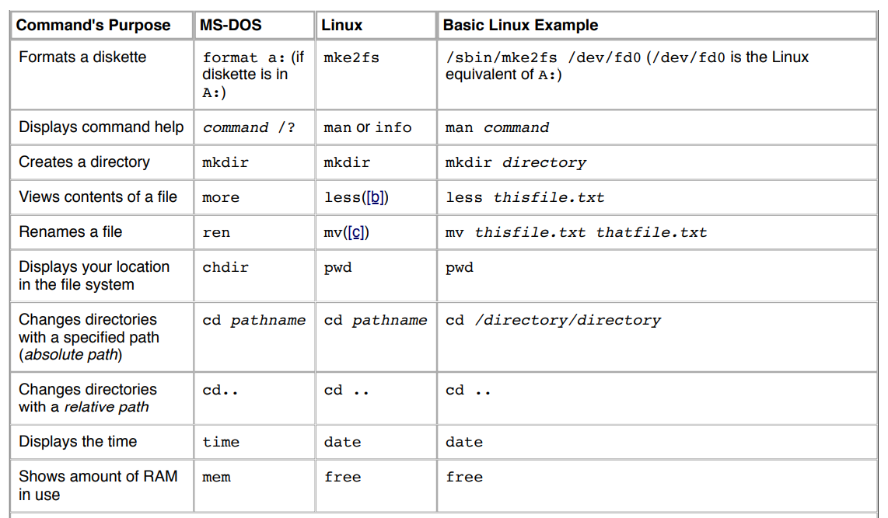

Slide 13
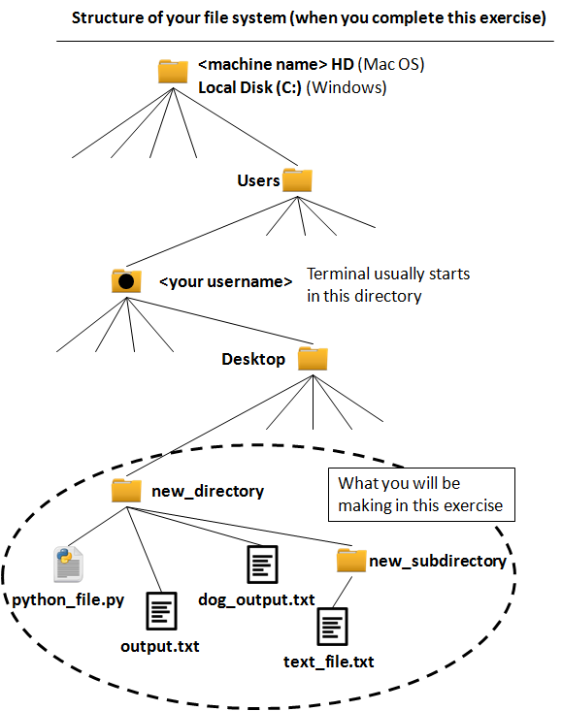
Review: Absolute path and relative path
Absolute path Path from root directory /Users/[Username]/Desktop/new_directory/output.txt Path from home directory ~/Desktop/new_directory/output.txt
Relative path If you are in "new_directory" output.txt If you are in "Desktop" new_directory/output.txt If you are in "new_subdirectory" ../output.txt

Slide 14
What will this do?

Slide 15
What will this do?

Slide 16
What will this do?

Slide 17
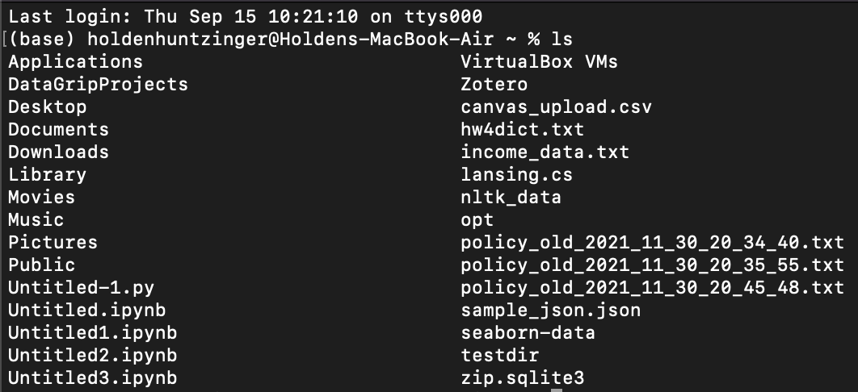
What will this do?

Slide 18
What will this do?

Slide 19
What will this do?

Slide 20
What will this do?

Slide 21
What will this do?

Slide 22
Please ask QUESTIONS

